Slide 1

CSC- 362 Computer Networks Week-10 Lecture:19 & 20
Prepared by:
Mr. Attique Ur Rehman

Slide 2
Internetworking

Slide 3
The Big Picture
You are here

Slide 4
Internetworking
Outline
Best Effort Service Model
Global Addressing Scheme

Slide 5
What we understand …
Concepts of networking
Elements of networks: nodes and links
Transmission, and units of communication data
How to detect transmission errors in a frame after encoding and framing it
How to simulate a reliable channel (sliding window)
How to arbitrate access to shared media in any network
Design issues of direct link networks
Functionality of network adaptors

Slide 6
We also understand …
How switches may provide indirect connectivity
Different ways to move through a network (forwarding)
Bridge approach to extending LAN concept
How switches are built and contention within switches
Next: lets different networks “work together”

Slide 7
Internetworking
Basics of Internetworking – Heterogeneity
The IP protocol, address resolution, control messages
Dealing with simple heterogeneity issues
Defining a service model
Defining a global namespace
Structuring the namespace to simplify forwarding
Hiding variations in frame size limits

Slide 8
Internetworking
Routing – moving forward with IP
Building forwarding information
Dealing with global internets - scale
Virtual geography and addresses
Hierarchical routing
Name translation and lookup: translating between global and local (physical) names
Multicast traffic
IPv6

Slide 9
Basics of Internetworking
What is an internetwork?
Illusion of a single (direct link) network
Built on a set of distributed, heterogeneous networks
Abstraction typically supported by software
Properties
Supports heterogeneity: independent of architecture, operating system, network type and topology
Scales to global connectivity
The Internet:
Specific global internetwork that grew out of ARPANET

Slide 10
Internet Protocol (IP)
Network protocol for the Internet
Advanced Research Projects Agency Network (ARPANET) developed original version of IP in 1983.
Operates on all hosts and routers (routers connect distinct networks into the Internet)

Slide 11
Internet Protocol (IP)
TFTP: Trivial File Transfer Protocol NV: Network Visualization
FTP
HTTP
NV
TFTP
TCP
UDP
IP
…
FDDI
Ethernet
ATM

Slide 12
Internet Protocol (IP)
Service model
Overview of message transmission
Host addressing and address translation
Datagram forwarding
Fragmentation and reassembly
Error reporting/control messages
Dynamic configuration
Protocol extensions through tunneling
Note: congestion control not handled by IP

Slide 13
IP Service Model
Provided to transport layer (TCP, UDP)
Global name space
Host-to-host connectivity (connectionless)
“Best effort” packet delivery (datagram-based)
No delivery guarantees on bandwidth, delay, etc.
Packet delayed for very long time
Packet lost
Packet delivered more than once
Packets delivered out of order
Simplest model: ability of IP to “run over anything”

Slide 14
Internetworks
Large scalable heterogeneous network of networks with efficient routing
Collection of networks providing host-to-host packet delivery service
A logical network built out of the physical networks connected by routers
Internet Protocol (IP) runs on all nodes to make them function as a single logical internetwork

Slide 15
Internetwork
Concatenation of networks
Protocol stack
H6
H7
H1
R3
Network 1
Ethernet
R1
Network 3
FDDI
Network 4
Ethernet
Network 2
Point
-to-
point
R2
H5
H2
H3
H8
H4
H1
H8
TCP
R1
R2
R3
TCP
IP
IP
IP
IP
IP
ETH
ETH
PPP
PPP
FDDI
FDDI
ETH
ETH
PPP: Point to Point Protocol FDDI: Fiber Distributed Data Interface

Slide 16
IPv4 Addresses
Properties
32 bit long hierarchical addresses: network + host
Managed by Internet Assigned Numbers Authority (IANA) and by five regional Internet registries (RIRs)
Globally unique, maps to interfaces rather than hosts
Exception is service request splitting, as is done with large web servers, for example
Out of 4 billion addresses, Traditional 3-class model
1/2 are class A
1/4 are class B
1/8 are class C
some addressing are reserved for special purpose
~270 million addresses for multicast
~18 million addresses for special purpose
The address space of IPv4 is 2³² or 4,294,967,296.

Slide 17
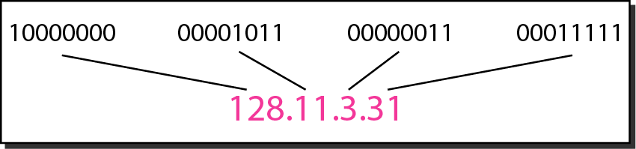
IPv4 Addresses
Each Internet Service Provider (ISP) or private network administrator assigns an IP address to each device connected to its network
Assignments of IP address may be on a static (fixed or permanent) or dynamic basis, depending on its software and practices
Often written using dot notation
10.3.2.4, 128.96.33.81

Slide 18
Global Addresses
Change the following IPv4 addresses from binary notation to dotted-decimal notation.
Solution
We replace each group of 8 bits with its equivalent decimal number and add dots for separation.

Slide 19
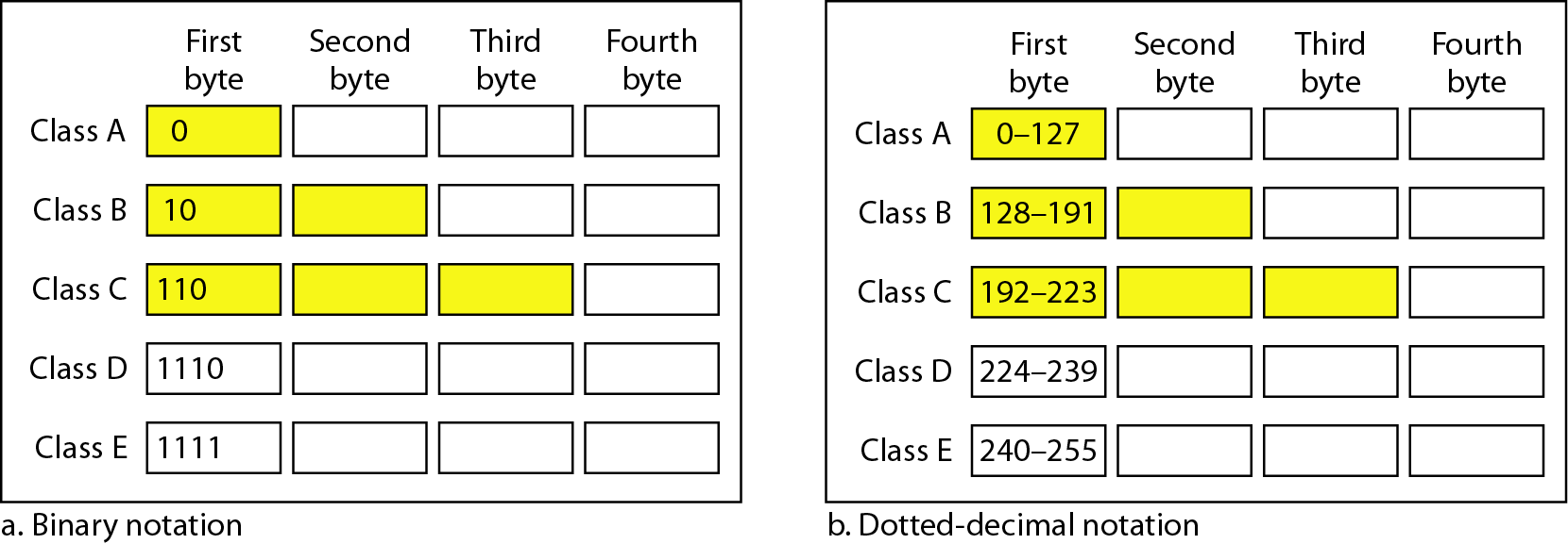
Finding Class from IP Address
Find the class of each address.
00000001 00001011 00001011 11101111
The first bit is 0. This is a class A address.
11000001 10000011 00011011 11111111
The first 2 bits are 1; the third bit is 0. This is a class C address
14.23.120.8
The first byte is 14; the class is A.
252.5.15.111
The first byte is 252; the class is E.

Slide 20
IP Addresses (Classful)
7 bits (126 nets)
24 bits (16 million hosts)
Class A:
0
Network
Host
14 bits (16k nets)
16 bits (64K hosts)
Class B:
1
0
Network
Host
21 bits (2 million nets)
8 bits (256)
Class C:
1
1
0
Network
Host
In classful addressing, the address space is divided into five classes:
A, B, C, D, and E.

Slide 21
IP Addresses (Classful)
18.10.5.22 host in class A network (MIT)
130.126.143.254 host in class B network (UIUC)
192.12.70.111 host in class C network
More recent classes
Multicast (class D): starts with 1110
Future expansions (class E): starts with 1111
In classful addressing, the address space is divided into five classes:
A, B, C, D, and E.

Slide 22
Number of blocks and block size in classful IPv4 addressing
In classful addressing, a large part of the available addresses were wasted.

Slide 23
Default masks for classful addressing
Classful addressing, which is almost obsolete, is replaced with classless addressing/Classless Inter-Domain Routing (CIDR) in 1993.

Slide 24
Classless Addressing
To overcome the address reduction and give more organizations access to the internet, classless addressing was designed and implemented.
In this scheme there is no classes, but the address are still granted in blocks.
Address blocks are assigned to entity (small or large) needs to be connected to internet.
Restrictions:
The address in a block must be contiguous, one after another
The no. of addresses in a block must be a power of 2 (1, 2, 4, 8, …..)
The first address must be evenly divisible by the no. of addresses

Slide 25
Mask in Classless Addressing
A mask is a 32-bit number in which the n leftmost bits are 1s and the 32-n rightmost bits are 0s
In classless addressing the mask for a block can take any value from 0 to 32.
In IPv4 addressing, a block of addresses can be defined as x.y.z.t /n in which x.y.z.t defines one of the addresses and the /n defines the mask.
CIDR is based on variable-length subnet masking (VLSM) to allow allocation and routing based on arbitrary-length prefixes

Slide 26
Address Block
The first address in the block can be found by setting the rightmost 32 − n bits to 0s.
The last address in the block can be found by setting the rightmost 32 − n bits to 1s.
The number of addresses in the block can be found by using the formula 2^{32−n}.
The first address in a block is normally not assigned to any device; it is used as the network address that represents the organization to the rest of the world.

Slide 27
Example 1
A block of addresses is granted to a small organization. We know that one of the addresses is 205.16.37.39/28. What is the first and address in the block ? Also find the no. of address.
Solution
The binary representation of the given address is
11001101 00010000 00100101 00100111
If we set 32−28 rightmost bits to 0, we get
11001101 00010000 00100101 00100000
or 205.16.37.32.
If we set 32 − 28 rightmost bits to 1, we get
11001101 00010000 00100101 00101111
or
205.16.37.47
The value of n is 28, which means that number of addresses is 2 ³²⁻²⁸ or 16.

Slide 28
Example 2
Another way to find the first address, the last address, and the number of addresses is to represent the mask as a 32-bit binary (or 8-digit hexadecimal) number. This is particularly useful when we are writing a program to find these pieces of information. In Example 1 the /28 can be represented as
11111111 11111111 11111111 11110000 (twenty-eight 1s and four 0s).
Find
a. The first address
b. The last address
c. The number of addresses.

Slide 29
Example 2
Solution
a. The first address can be found by ANDing the given addresses with the mask. ANDing here is done bit by bit. The result of ANDing 2 bits is 1 if both bits are 1s; the result is 0 otherwise.

Slide 30
Example 2
b. The last address can be found by ORing the given addresses with the complement of the mask. ORing here is done bit by bit. The result of ORing 2 bits is 0 if both bits are 0s; the result is 1 otherwise. The complement of a number is found by changing each 1 to 0 and each 0 to 1.

Slide 31
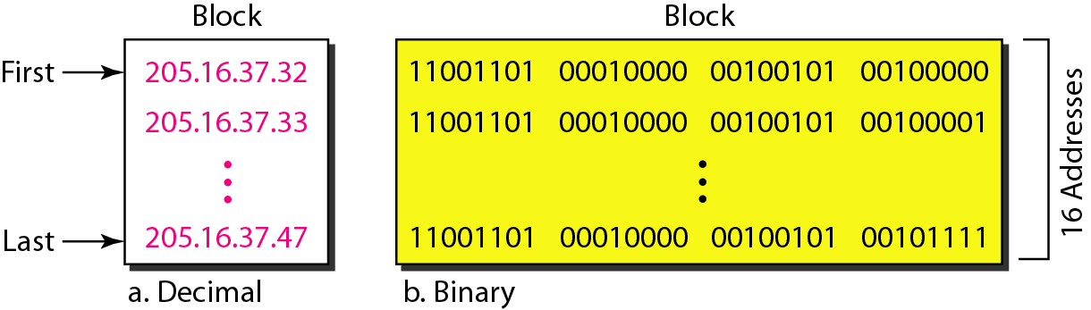
Example 2

Slide 32
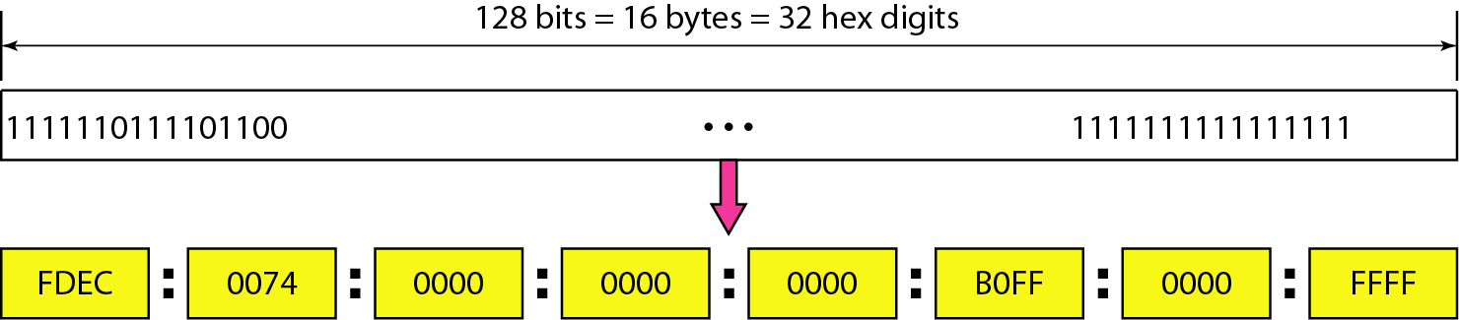
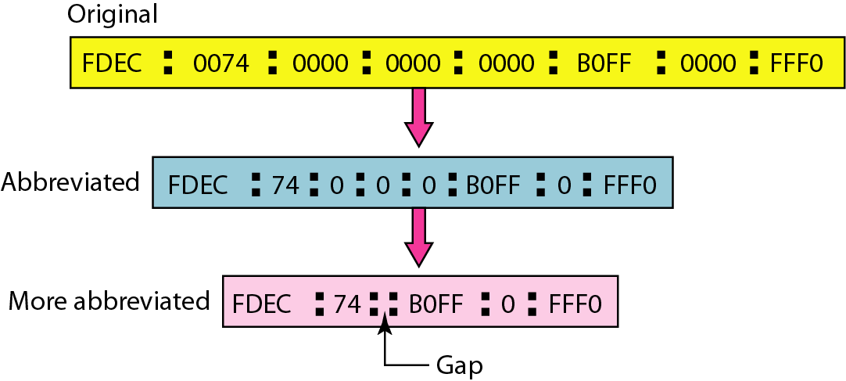
IPv6 Addresses
Properties
128 bit long

Slide 33
IPv6 Addresses Example
Expand the address 0:15::1:12:1213 to its original.
Solution
We first need to align the left side of the double colon to the left of the original pattern and the right side of the double colon to the right of the original pattern to find how many 0s we need to replace the double colon.
This means that the original address is.

Slide 34
Comparison between IPv4 and IPv6 Addressing
IPv4 Address | IPv6 Address
Address Length – 32 bits | 128 bits
Address Representation - decimal | hexadecimal
Internet address classes | Not applicable in IPv6
Multicast addresses (224.0.0.0/4) | IPv6 multicast addresses (FF00::/8)
Broadcast addresses | Not applicable in IPv6
Unspecified address is 0.0.0.0 | Unspecified address is ::
Loop-back address is 127.0.0.1 | Loop-back address is ::1
Public IP addresses | Global uni-cast addresses
Private IP addresses (10.0.0.0/8, 172.16.0.0/12, and 192.168.0.0/16) | Site-local addresses (FEC0::/10)
Auto-configured addresses (169.254.0.0/16) | Link-local addresses (FE80::/64)

Slide 35
Advantages of IPv6
No more NAT (Network Address Translation)
Auto-configuration
No more private address collisions
Better multicast routing
Simpler header format
Simplified, more efficient routing
True quality of service (QoS), also called "flow labeling"
Built-in authentication and privacy support
Flexible options and extensions
Easier administration (say good-bye to DHCP)

